Slide 1

Pulsed EPR Study of Porphyrin-Functionalized Graphene Nanoribbons
Fanmiao Kong
Department of Materials, Trinity College
Oxford University
27/07/2022

Slide 2
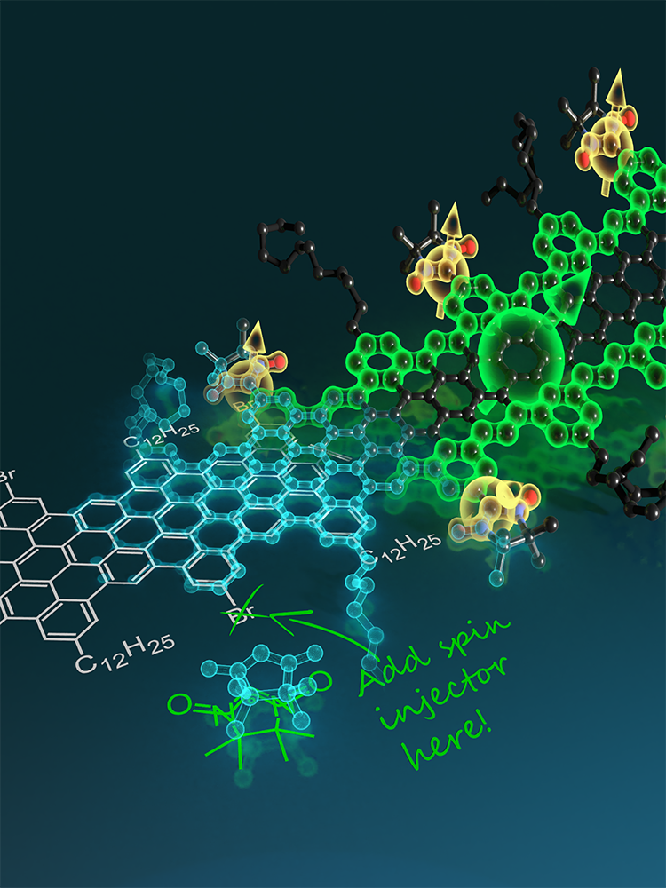
Graphene Nanoribbons (GNRs)
Fascinating electronic properties
Tunable band gap
Spin-filtering zigzag edge states
Topological phase
Long spin coherence time
Bottom-up synthesis approach
1

Slide 3
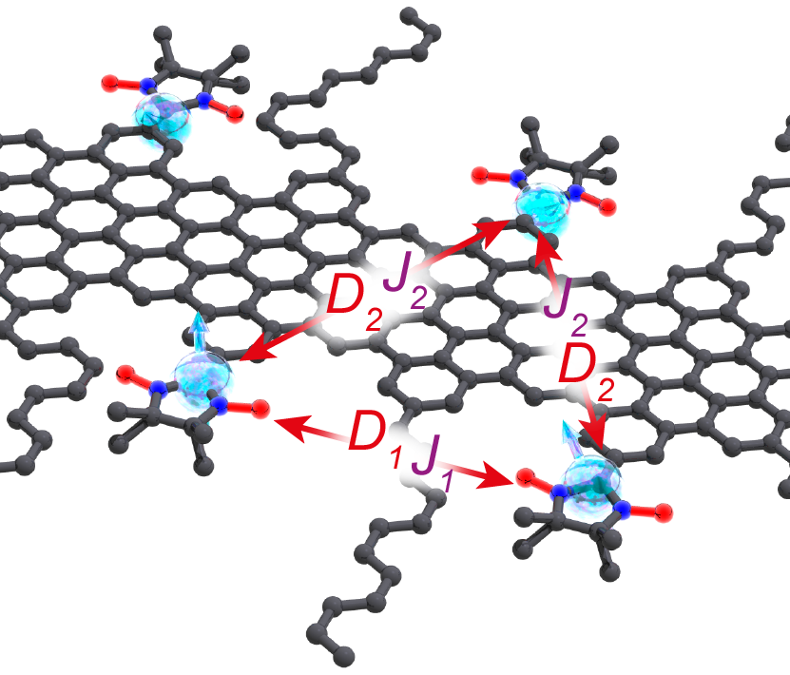
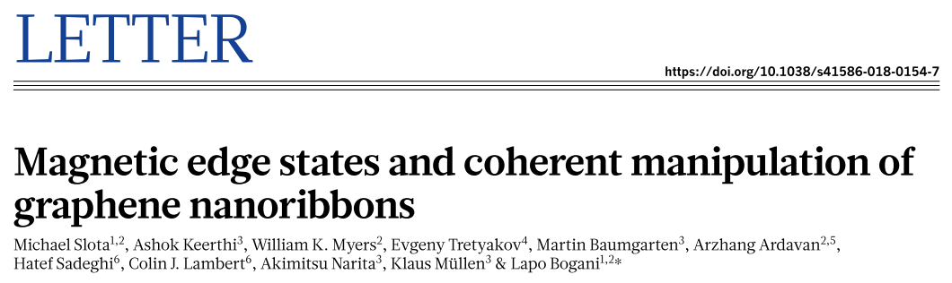
Graphene Nanoribbons (GNRs)
Fascinating electronic properties
Tunable band gap
Spin-filtering zigzag edge states
Topological phase
Long spin coherence time
Bottom-up synthesis approach
Nitronyl nitroxide-functionalized graphene nanoribbon (NIT-GNR)
1

Slide 4
Graphene Nanoribbons (GNRs)
Fascinating electronic properties
Tunable band gap
Spin-filtering zigzag edge states
Topological phase
Long spin coherence time
Bottom-up synthesis approach
Nitronyl nitroxide-functionalized graphene nanoribbon (NIT-GNR)
Introduce spin states using other functionalized groups?
Can we improve Tm?
1
Notes:
Because in NIT-GNR, the alkyl chain is not bulky enough to separate GNRs. There is a lot of pi-pi stacking which can assist the decoherence.

Slide 5
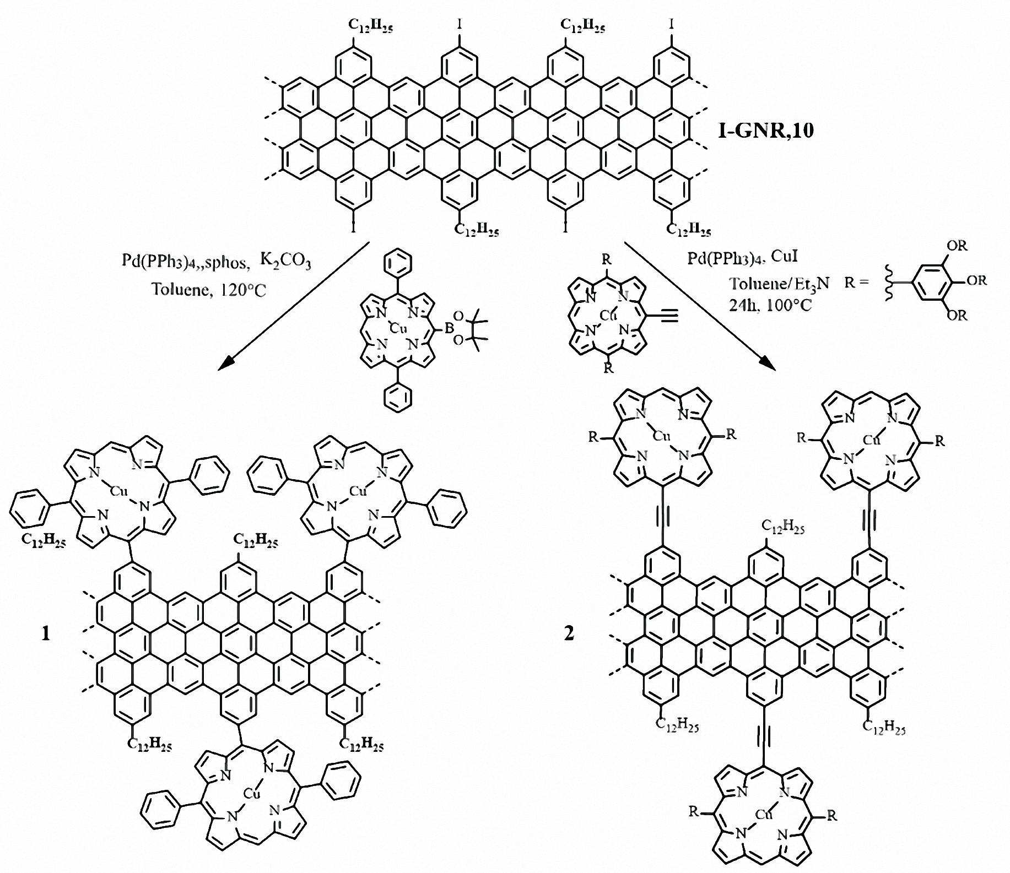
Porphyrin-Functionalized GNRs
Adjustable metal centers
Spin1/2
Spin1/2
Suz-Cu-GNR, 1
SG-Cu-GNR, 2
VO-GNR
Single bonds
(Suzuki coupling)
Triple bonds
(Sonogashira coupling)
Synthesized by Alicia Götz, Xuelin Yao, Dimitris Alexandropoulos
2
Notes:
Copper and Vanadyl porphyrins are well studied. And the Vanadyl porphyrin are known to have large spin coherence times. We want to know what will happen if we connect the copper and vanadyl porphyrin to the graphene nanoribbon.

Slide 6
Porphyrin-Functionalized GNRs
Adjustable metal centers
Suz-Cu-GNR, 1
SG-Cu-GNR, 2
VO-GNR
Single bonds
(Suzuki coupling)
Triple bonds
(Sonogashira coupling)
Synthesized by Alicia Götz, Xuelin Yao, Dimitris Alexandropoulos
2

Slide 7
Porphyrin-Functionalized GNRs
Adjustable metal centers
Bulky group to enhance solubility
Suz-Cu-GNR, 1
SG-Cu-GNR, 2
VO-GNR
Single bonds
(Suzuki coupling)
Triple bonds
(Sonogashira coupling)
Synthesized by Alicia Götz, Xuelin Yao, Dimitris Alexandropoulos
2
Notes:
As mentioned before, the spin coherence time in NIT-GNR is limited by the pi-pi stacking. So we tried to add this bulky group to prevent the pi-pi stacking of the ribbons. It turns out that this ribbon is very soluble in a couple of solvents like tetralin and toluene.

Slide 8
Porphyrin-Functionalized GNRs
Adjustable metal centers
Suz-Cu-GNR, 1
SG-Cu-GNR, 2
VO-GNR
Powders
Powders and solutions (tetralin)
2

Slide 9
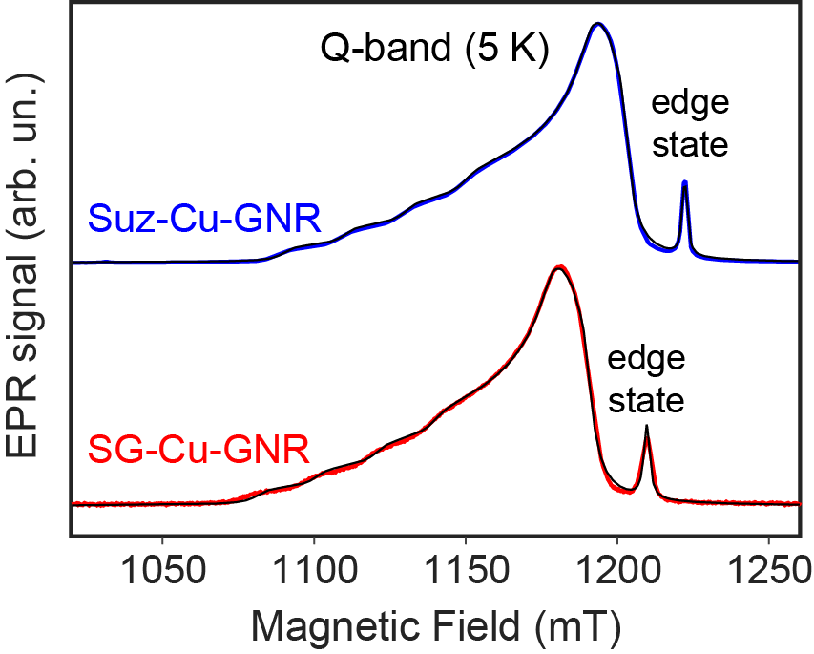
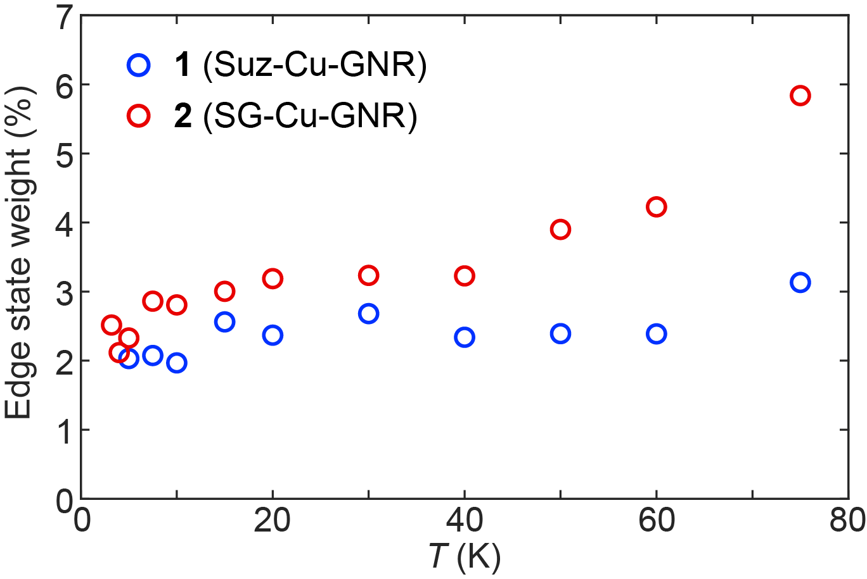
EPR Spectra of Cu-GNRs
Perfect fit using EASYSPIN
Additional sharp peak attributed to spin states in GNRs
Triple-bonds seem to provide a larger spin-injection efficiency
3
Notes:
FID defected spectra. The black lines are a fit using Easyspin, which is almost perfect. The broad peak comes from the copper porphyrin spins. In addition we have a sharp peak and it can be attributed to the spin states in GNRs
So in the fitting we used two spin species with different weight. And we get the weight of edge states of the two different Cu-GNRs. The red one is connected by triple bond, while blue one is single bond. So we can conclude that the triple bonds provide a larger spin injection efficiency.

Slide 10
EPR Spectra of Cu-GNRs
Parameter | Suz-Cu-GNR | SG-Cu-GNR
g_{||,Cu} g_{ꓕ,Cu} | 2.045(1) 2.186(1) | 2.044(1) 2.182(1)
A_{||,Cu} A_{ꓕ,Cu} | 86 ± 10 MHz 600 ± 10 MHz | 89 ± 10 MHz 595 ± 10 MHz
g_{iso,edge} | 2.0033(3) | 2.0016(3)
Perfect fit using EASYSPIN
Additional sharp peak attributed to spin states in GNRs
Triple-bonds seem to provide a larger spin-injection efficiency
3

Slide 11
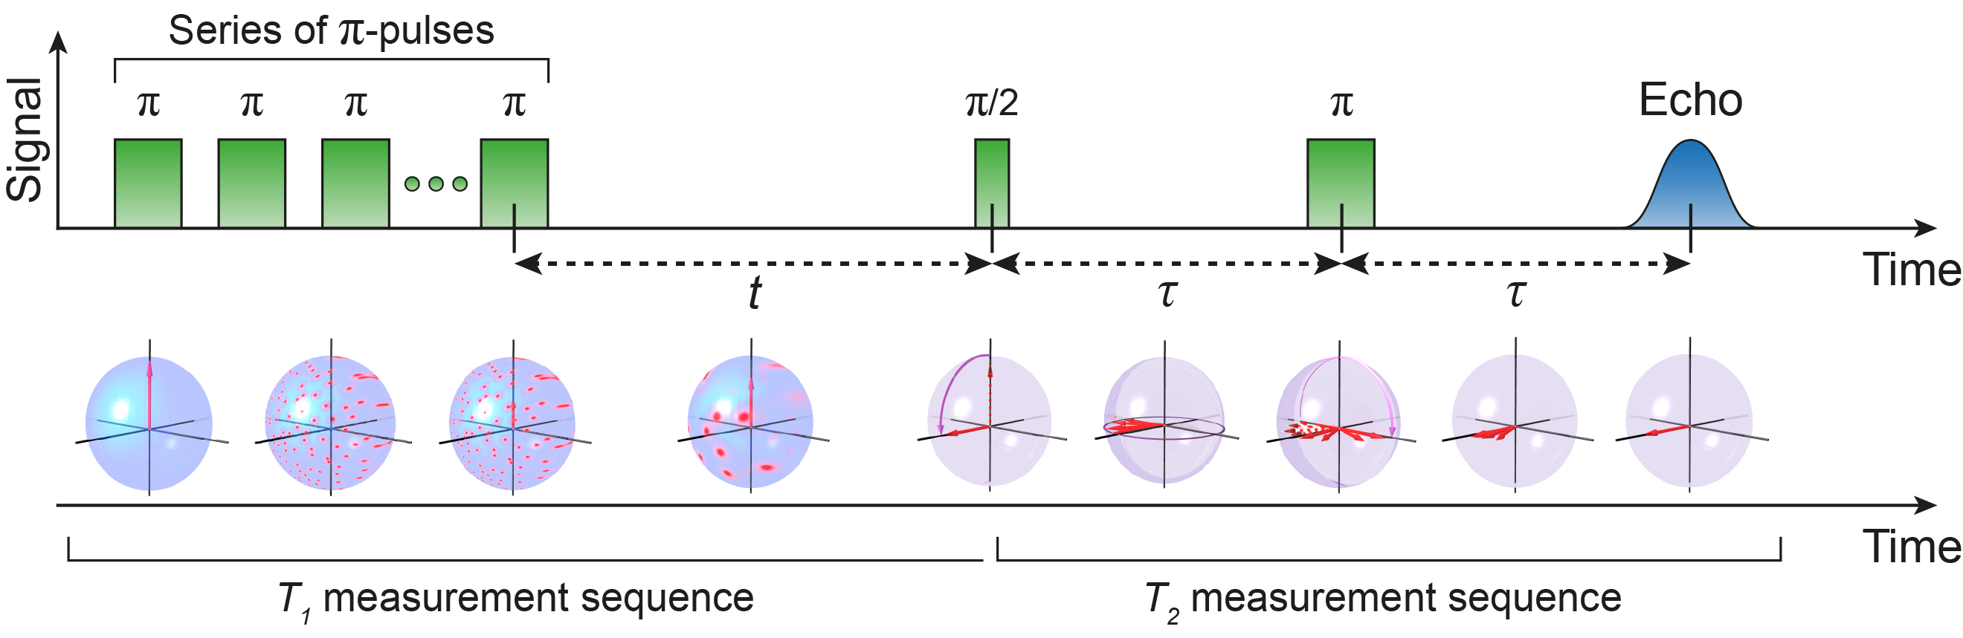
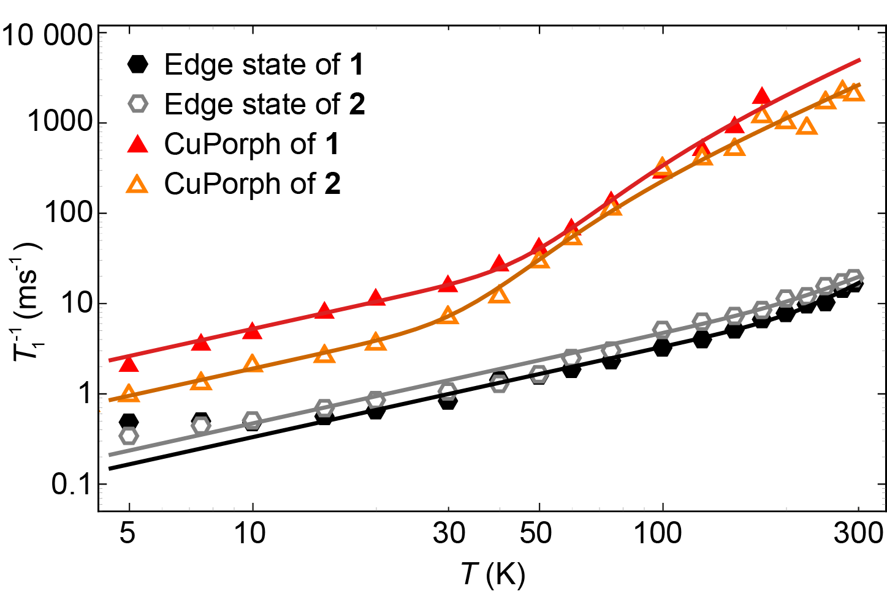
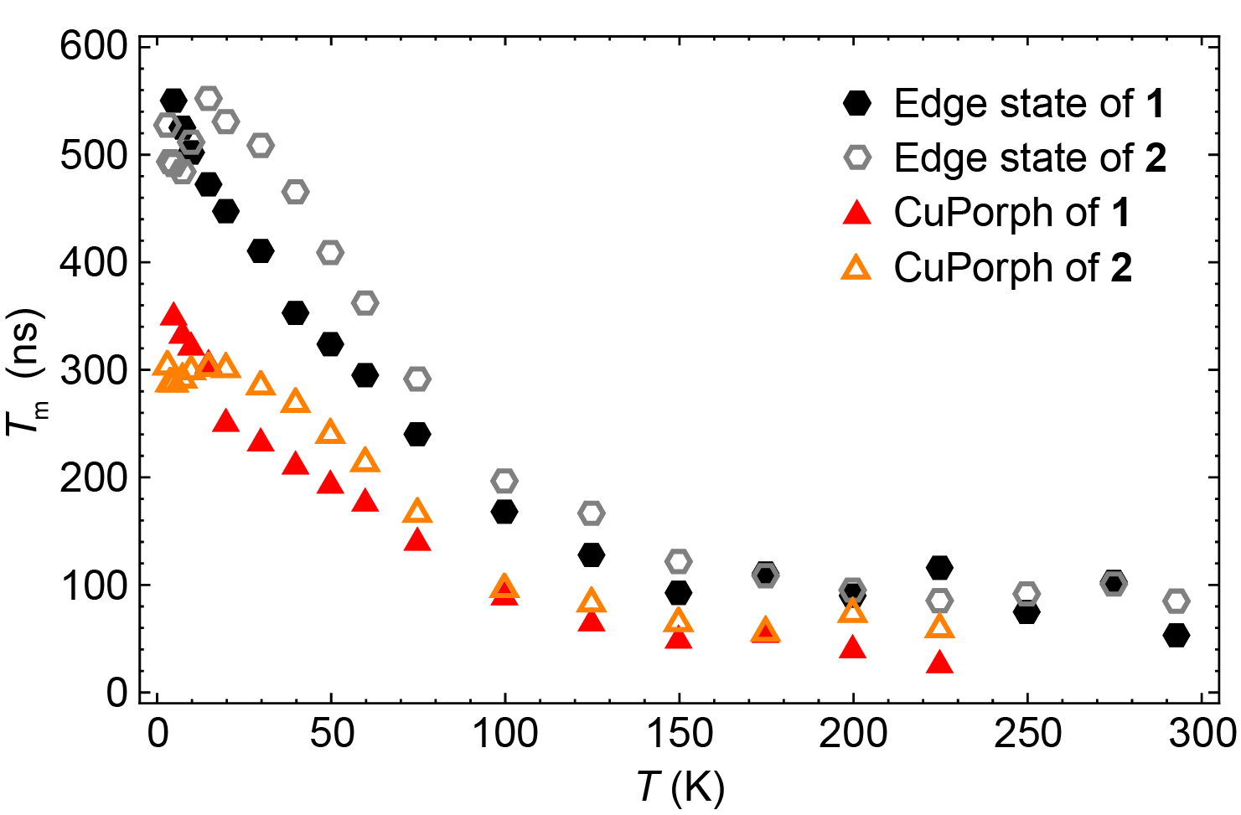
Spin Dynamics of Cu-GNRs
Pulses
Spin dynamics
T_{m}
4
Notes:
1 uses single bond connection, 2 triple bond. We plotted the inverse of T1 versus temperature, and Tm versus temperature

Slide 12
Spin Dynamics of Cu-GNRs
4

Slide 13
Spin Dynamics of Cu-GNRs
Edge state shows larger spin–lattice relaxation times than the Cu spins
These spins show both direct and Raman relaxation
The relaxation of the edge state is significantly different, likely a direct result of the coupling to the carbon lattice
4

Slide 14
Spin Dynamics of Cu-GNRs
Edge state shows larger spin–lattice relaxation times than the Cu spins
These spins show both direct and Raman relaxation
The relaxation of the edge state is significantly different, likely a direct result of the coupling to the carbon lattice
Edge state shows larger Tm than Cu spins
No effects of spin injection on the spin dynamics
4

Slide 15
Spin Dynamics of Cu-GNRs
Edge state shows larger spin–lattice relaxation times than the Cu spins
These spins show both direct and Raman relaxation
The relaxation of the edge state is significantly different, likely a direct result of the coupling to the carbon lattice
Edge state shows larger Tm than Cu spins
No effects of spin injection on the spin dynamics were observed
However, the Cu-GNRs are not soluble…
4
Notes:
However, the Cu-GNRs are not soluble enough. Because we used the long alkyl chains in Cu-GNRs. In order to further increase the spin coherence time, we considered adding bulky groups. And we have already known that vanadyl spins have long spin coherence time. So now I’m gonna show you our new generation of graphene nanoribbons with vanadyl porphyrins and bulky groups, which are very soluble.

Slide 16
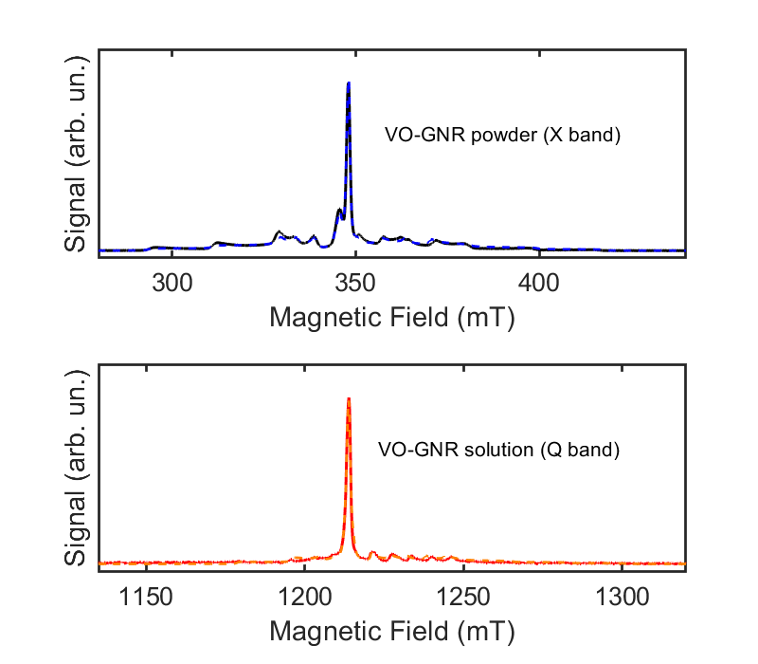
EPR Spectra of VO-GNR
Parameter | VO-GNR powder | VO-GNR solution
g_{||,V} g_{ꓕ,V} | 1.981(1) 1.958(2) | 1.983(2) 1.961(2)
A_{||,V} A_{ꓕ,V} | 166 ± 1 MHz 476 ± 1 MHz | 155 ± 2 MHz 477 ± 7 MHz
g_{iso,edge} | 1.9991(1) | 2.001(1)
5

Slide 17
EPR Spectra of VO-GNR
Peak from edge states in GNR
Parameter | VO-GNR powder | VO-GNR solution
g_{||,V} g_{ꓕ,V} | 1.981(1) 1.958(2) | 1.983(2) 1.961(2)
A_{||,V} A_{ꓕ,V} | 166 ± 1 MHz 476 ± 1 MHz | 155 ± 2 MHz 477 ± 7 MHz
g_{iso,edge} | 1.9991(1) | 2.001(1)
8 peaks from hyperfine coupling (Vanadyl nuclear spin I = 7/2)
5

Slide 18
EPR Spectra of VO-GNR
Peak from edge states in GNR, what if they are defects?
Parameter | VO-GNR powder | VO-GNR solution
g_{||,V} g_{ꓕ,V} | 1.981(1) 1.958(2) | 1.983(2) 1.961(2)
A_{||,V} A_{ꓕ,V} | 166 ± 1 MHz 476 ± 1 MHz | 155 ± 2 MHz 477 ± 7 MHz
g_{iso,edge} | 1.9991(1) | 2.001(1)
8 peaks from hyperfine coupling (Vanadyl nuclear spin I = 7/2)
5

Slide 19
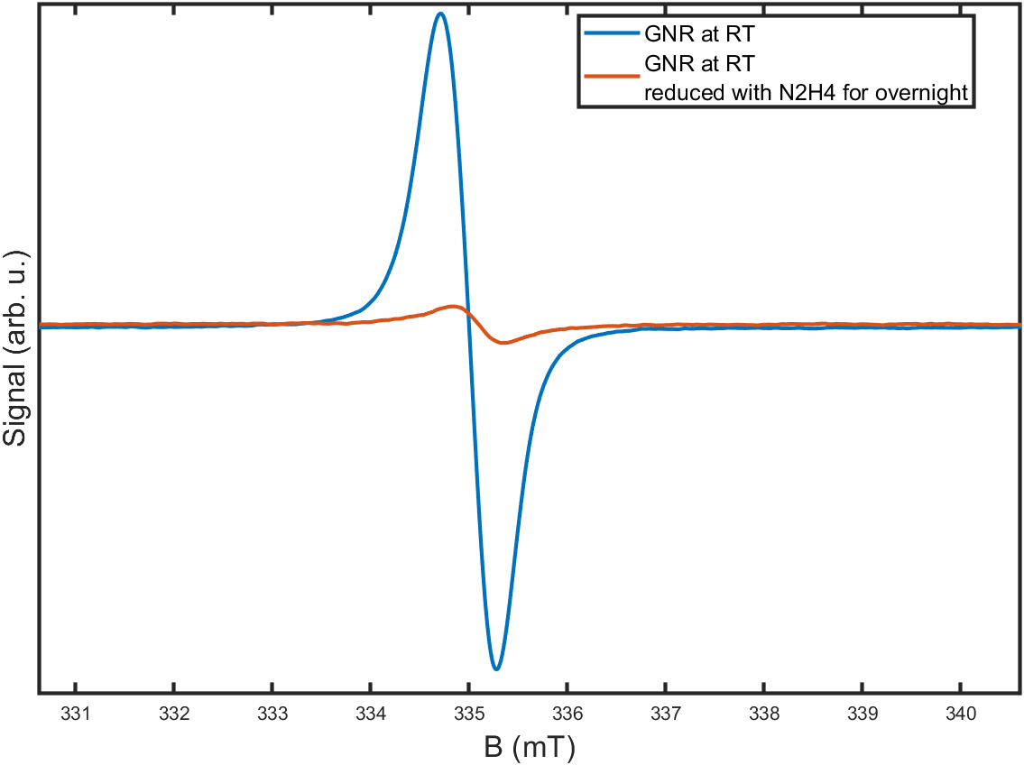
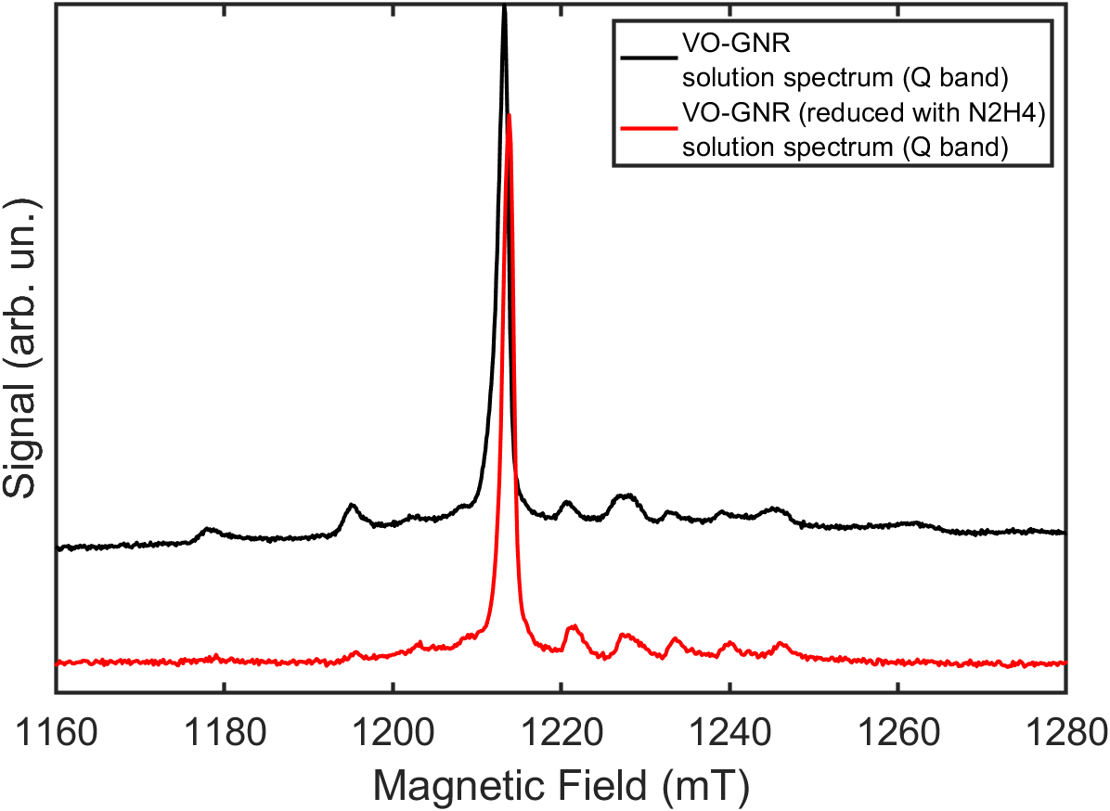
EPR Spectra of VO-GNR
CW EPR Signal of GNRs
CW EPR Signal of VO-GNRs
Residue defects in GNRs are greatly reduced by hydrazine.
Edge state peak of VO-GNRs persists after being reducing.
→ Rules out the influence of defects in GNR backbone.
6

Slide 20
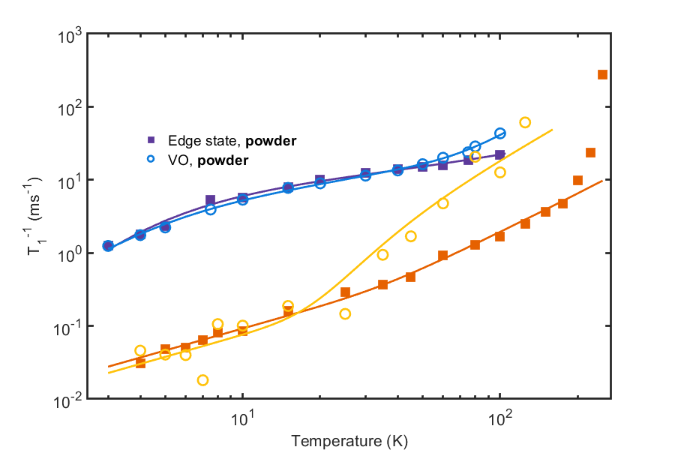
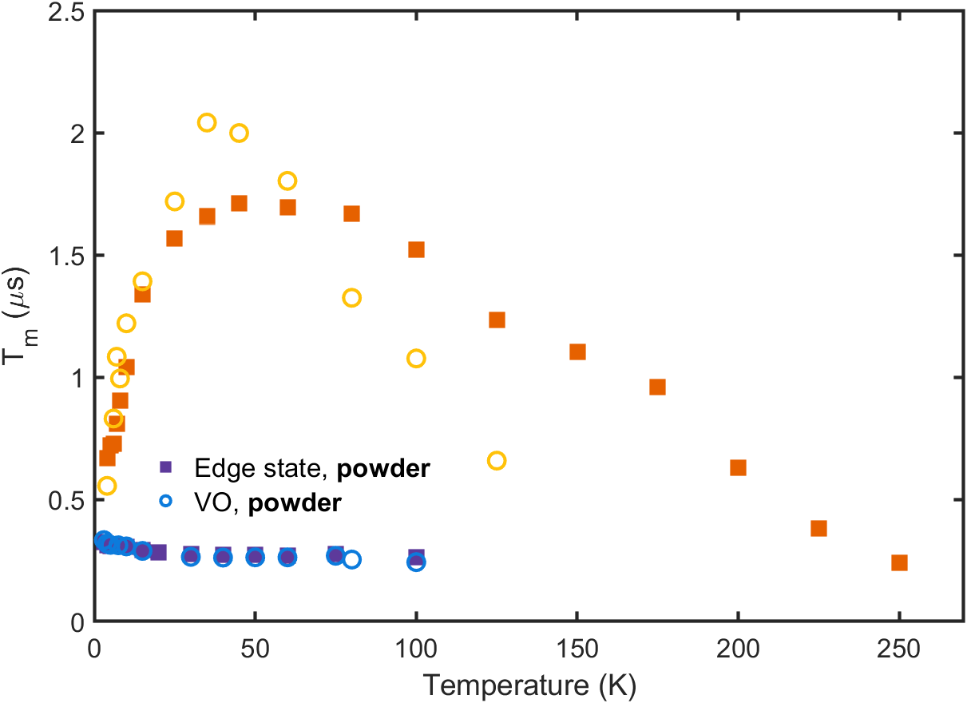
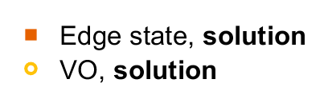
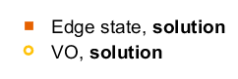
Spin Dynamics of VO-GNR
7

Slide 21
Spin Dynamics of VO-GNR
T₁ of solution sample is two orders higher than powder sample
Edge state and VO spins show different relaxation behaviours.
The T₁ of VO spin decreases faster with temperature.
7

Slide 22
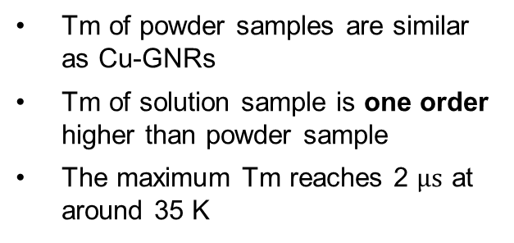
Spin Dynamics of VO-GNR
T₁ of solution sample is two orders higher than powder sample
Edge state and VO spins show different relaxation behaviours.
The T₁ of VO spin decreases faster with temperature.
Tm of powder samples are similar as Cu-GNRs
Tm of solution sample is one order higher than powder sample
The maximum Tm reaches 2 $μs$ at around 35 K
7

Slide 23
Conclusion
Porphyrins work as efficient spin injectors when grafted to graphene nanoribbons. Both single and triplet bond connections lead to spin states in GNRs.
Bulky groups can significantly improve the solubility and thus enhance the spin coherence time by one order of magnitude.
Graphene nanoribbons can be the testbed for creating more functional molecules by rational design of the structure.
Integrating functionalized GNRs into single molecule devices.
8
Notes:
Plenty

Slide 24



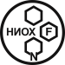

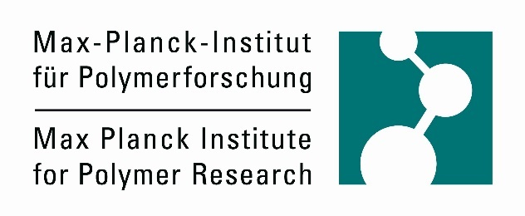

Acknowledgements
University of Oxford
Lapo Bogani
Xuelin Yao
Dimitris Alexandropoulos
Michael Slota
Karen Yan
William Myers
Max Planck Institute for Polymer Research, Mainz
Ashok Keerthi
Martin Baumgarten
Klaus Müllen
Novosibirsk Institute of Organic Chemistry
Evgeny Tretyakov
OIST
Akimitsu Narita
Alicia Götz

